Slide 1
Beam Deflections
March 21, 2012
Alisa Baker Jeff Furman Kimberly Phongprateep Anton Volosciuc

Slide 2
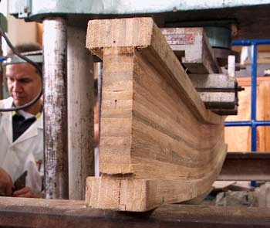
Not beam reflections…
But beam deflections…
Notes:
For an initial clarification, our presentation is not on beam reflections, but it is on beam deflections. As you can see here in this picture, this wooden beam is being deflected by the load positioned at the center.

Slide 3
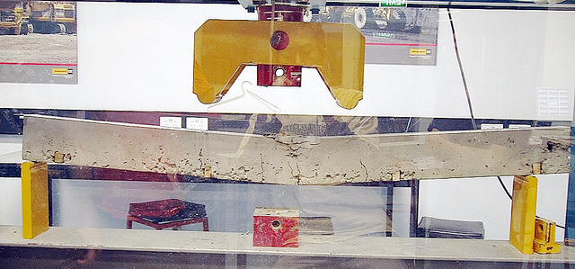
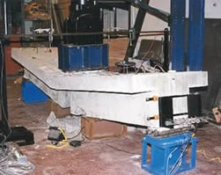
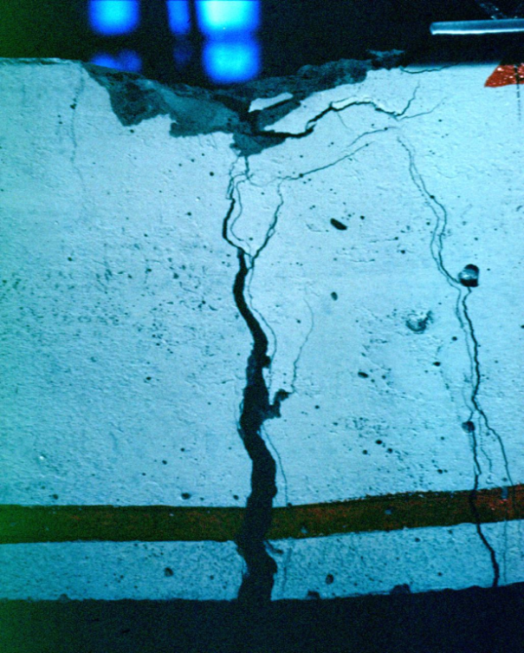
Beam Failures
Notes:
Beam deflection is an important subject because as you can see here, without the understanding of loading and span, properties, and shapes of the beams, applications in the real world can turn out to be very dangerous.

Slide 4
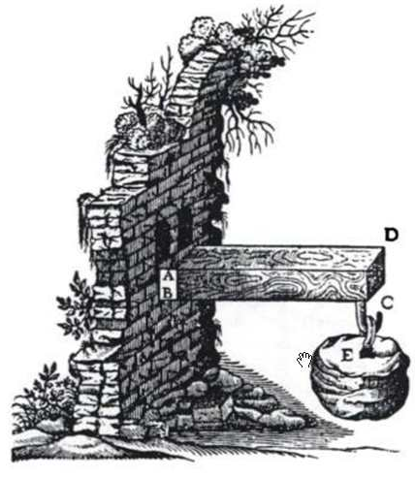
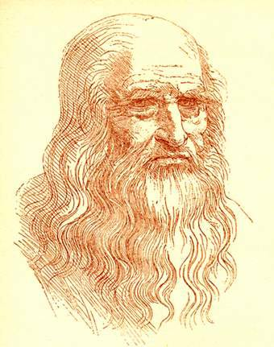
Galileo Galilei Astronomer, Physicist (1564-1642)
Cantilevered beam
L
F
Torque (moment) = FL
Leonardo da Vinci
Painter, Sculptor, Architect, Musician, Scientist, Mathematician,
Engineer, Inventor, Anatomist, Geologist, Cartographer, Botanist, Writer
(1452-1519)
Notes:
Galileo was one of the first people that started to think about the quantitative properties of beams, but he had no mathematical tools available. Leonardo da Vinci, 100 years earlier, had the same work as Galileo, but he also correctly identified the stress and strain distribution across a section in bending.

Slide 5
Boundary Conditions
Cantilevered beam
Mixed (fixed-simple)
Simple supported
Notes:
These are three different type of boundary conditions. A cantilevered beam is attached to a wall at one end and is free at the other end, such as the picture drawn up by Galileo. The second picture is of a mixed condition—the beam is attached to a wall at one end and is supported at the other end. The boundary condition that we will be learning about is the simple supported beam. As you can see, the beam is supported at both ends.

Slide 6
Loading and Span
Uniform loading
Non uniform loading
Point loading
Span = distance between supports
Notes:
Here we have uniform loading. That would be as if there is a constant force being applied all along the length of the beam. The non uniform loading has an unevenly distributed weight on the beam. An example of this would be like beams in a warehouse with pillows on one end and pianos on the other end. The loading we will focus on is center-point loading, which has one particular place where the weight force is applied on the beam.

Slide 7
Simple Load Beam
a
Beam
L
Given as weight at position

Slide 8
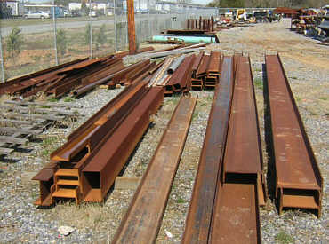
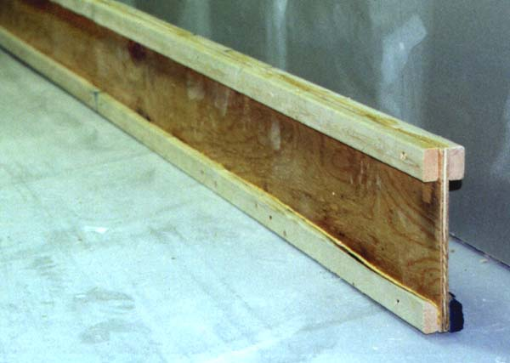
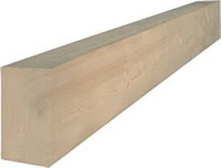
Common Material Properties
Steel
E = modulus of elasticity
= 30 x 10⁶ psi
Wood
E = 1.3 x 10⁶ psi
Notes:
Here are the two more common material properties of beams: steel and wood. In the pictures, the steel beams are in the shape of an uppercase letter I. The wooden beam is naturally block-shaped, but can also be formed into an I-shape. The variable E represents the modulus of elasticity, which is the amount that the material will bend before breaking.

Slide 9
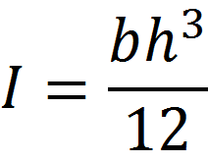
Properties of the shape of the beam
I = Second Moment of inertia of a beam cross section about a definite axis, perpendicular to bending plane
Simple case– rectangular cross section:
h
axis
h
axis
b
b
Notes:
The variable I represents the second moment of inertia of a beam cross section about a definite axis. This definite axis is perpendicular to the bending plane. The diagram here is a vertical beam and has an inertia formula shown here. But since we’re discussing horizontal beams, if you rotate the beam 90 degrees, the b and h become swapped and the axis is then along the length of the beam. The beam is now noticeably weaker. (YARD STICK DEMO)

Slide 10
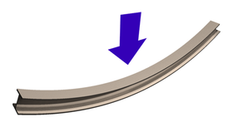
Beams Bend & the Applied Load
Based on beam properties
Stiffness (E, modulus of elasticity)
Unit stress = force/area
I beam
compression
Moment
Force
tension
Notes:
(JEFF’S CARD DEMO)

Slide 11
Force, Stress, and Strain
Force
Tension is a pulling force
Compression is a squeezing force
Together, you get shear
Stress
force per unit area that the force acts upon
Both the bending moment and shear force causes stresses in the beam
Strain
change in length of a stressed structural element divided by the original length of the unstressed element

Slide 12
Load, Shear, and Moment
Load = F(x) = mg
g = 9.81m/s²
Shear = V(a) = F(x)dx, function of position
positive shear
Moment = M(a) = V(x)dx, function of position
F(0)
L
F(L)
x
V
x
M
x

Slide 13
Moment & Deflection
θ(a)= M(x)dx
θ
Notes:
The deflection is the angle, usually θ, that the beam bends or sags. The deflection is found by integrating the moment of the beam in respect to position of applied force. Because the force is applied at the center of the beam, the beam will sag the most at the center. If the force were applied elsewhere on the beam, like more towards the right, the sag would be lopsided.

Slide 14
Mr. Mosh sits on a bench
Approximate weight: 75kg
Length of bench: 2m
Height of bench: 101.6mm
Strength of bench: 1.3 x 10⁶ psi
How far will the bench bend?

Slide 15
Analysis
Mosh way
Easy way
Step 1
Define the load
Step 2
Integrate the load to find shear
Step 3
Integrate the shear to find the moment
Step 4
Integrate the moment to find the deflection
F = weight force, in Newtons
L = length of beam, in meters
E = modulus of elasticity, in N/mm⁴
I = moment of inertia, in mm⁴

Slide 16
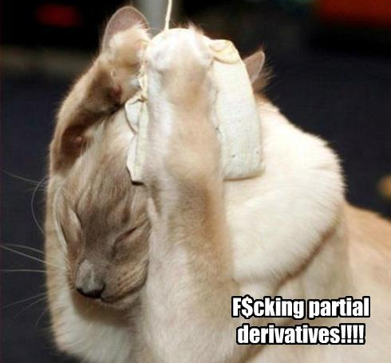
Question? Just one.

